Slide 1

Analysis of Accident severity in Seattle, WA
Ryan Schmitt

Slide 2
Purpose
Identify where in Seattle that accidents are occurring.
Build a model to accurate predict an automobile accident’s severity.
Test several models to confirm accuracy.
Advise on location first responder resources.

Slide 3
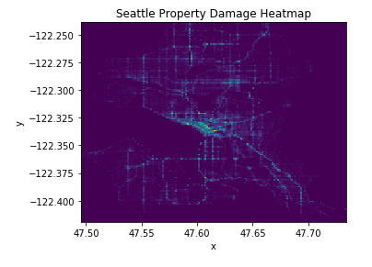
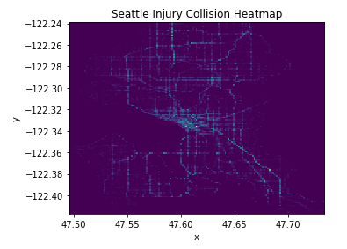
Seattle Accident Heatmaps

Slide 4
Seattle Accident Heatmaps
Most of the accidents only involving property damage seem concentrated to the downtown area of Seattle
Most of the accidents involving injury collisions also seem concentrated to the downtown area of Seattle.
The southern parts of Seattle seem to have less accidents overall than the northern parts of Seattle.

Slide 5
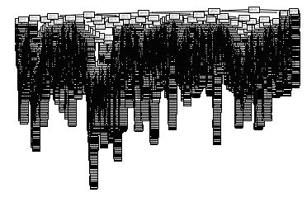
Model Generation and Accuracy
Decision Trees
Accuracy score was 68.552%. Display is very difficult to use stand-alone.

Slide 6
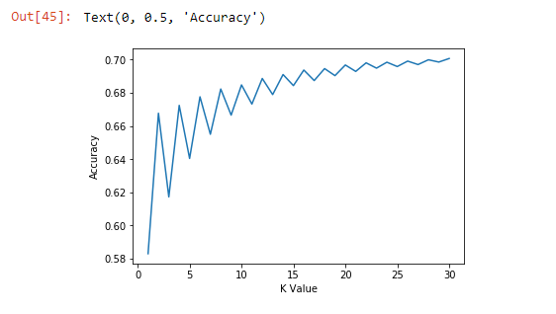
Model Generation and Accuracy
K-Nearest Neighbor
Accuracy score is 70.070%. The best k = 30.

Slide 7
Model Generation and Accuracy
Support Vector Machine
Kernel used was Radial Basis Function.
Accuracy score was 70.342%.

Slide 8
Ways to improve
Gather more data
Was the driver on the phone?
Age of driver / overall driving experience?
Was the driver wearing a seatbelt?
This data would help first responder response time with the correct resources on location.

Slide 9
Conclusions
In general, station more injury EMT response resources in downtown.
There is also a preference to position more resources to the northern part of the city versus the southern part.
Study driving conditions – deeper analysis is needed on the primary causes of accidents in the northern, southern, and downtown regions of Seattle.

